Slide 1
Introduction to the Operating System
Name : Rupak Sarkar Roll No.: 14271024036 Stream : MCA Semester : Semester 2nd Subject : Operating System Subject Code : MCAN-202

Slide 2
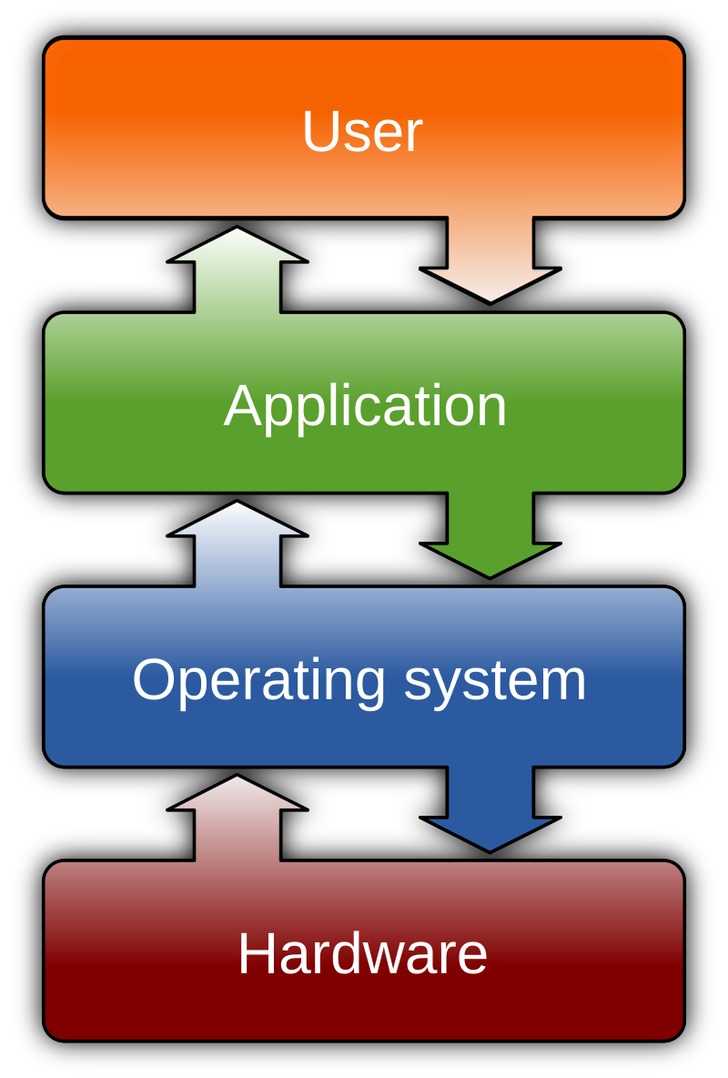
What is Operating System?
An Operating System is a System software that manages all the resources of the computing device.
Acts as an interface between the software and different parts of the computer or the computer hardware.
Manages the overall resources and operations of the computer.
Controls and monitors the execution of all other programs that reside in the computer, which also includes application programs and other system software of the computer.
Examples of Operating Systems are Windows, Linux, macOS, Android, iOS, etc.

Slide 3
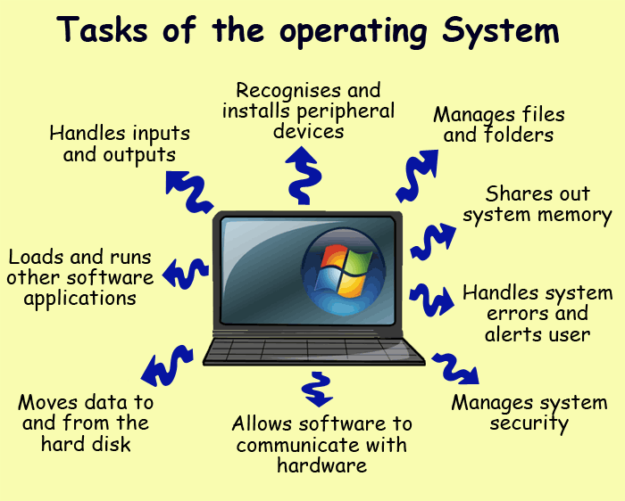
What is an Operating System used for?
As a platform for Application programs: It provides a platform, on top of which, other programs, called application programs can run.
Multitasking: It manages memory and allows multiple programs to run in their own space and even communicate with each other through shared memory.
Manages memory and Files: It manages the computer’s main memory and second storage.
Provides Security: It helps to maintain the system and applications safe through the authorization process.

Slide 4
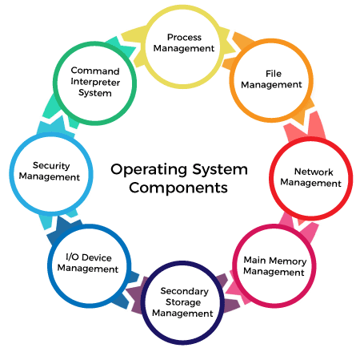
Goals of Operating System
The goals of an operating system (OS) can be categorized into several key areas:
Security and Access Control – The OS enforces user authentication, permissions, and security measures to prevent unauthorized access.
User Interface (UI) and User Experience – It provides a user-friendly interface, such as a graphical user interface (GUI) or command-line interface (CLI), to interact with the system.
Efficient Resource Management – The OS manages CPU, memory, storage, and I/O devices efficiently to ensure optimal performance.
Multitasking and Multiuser Support – It allows multiple processes and users to work simultaneously without interference.

Slide 5
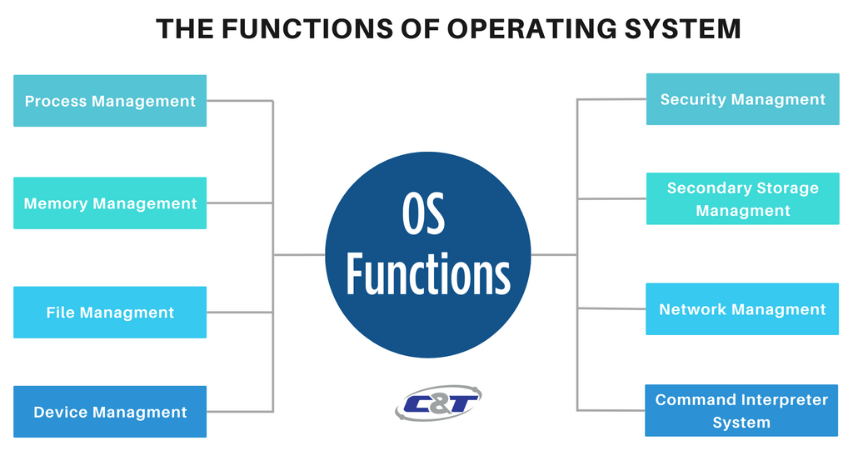
Functions of Operating System
Memory Management
All data in memory before and after processing
All instructions in memory in order to execute
Memory management determines what is in memory when
Optimizing CPU utilization and computer response to users
Keeping track of which parts of memory are currently being used and by whom

Slide 6
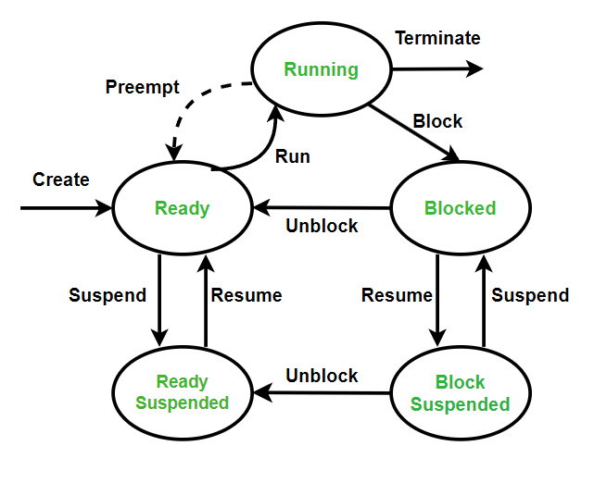
Process Management
The operating system is responsible for the following activities in connection with process management:
Creating and deleting both user and system processes
Suspending and resuming processes
Providing mechanisms for process synchronization
Providing mechanisms for process communication
Providing mechanisms for deadlock handling

Slide 7
Security Management
Protection – any mechanism for controlling access of processes or users to resources defined by the OS
Security – defense of the system against internal and external attacks
Huge range, including denial-of-service, worms, viruses, identity theft, theft of service
Systems generally first distinguish among users, to determine who can do what
User identities (user IDs, security IDs) include name and associated number, one per user
User ID then associated with all files, processes of that user to determine access control
Group identifier (group ID) allows set of users to be defined and controls managed, then also associated with each process, file

Slide 8
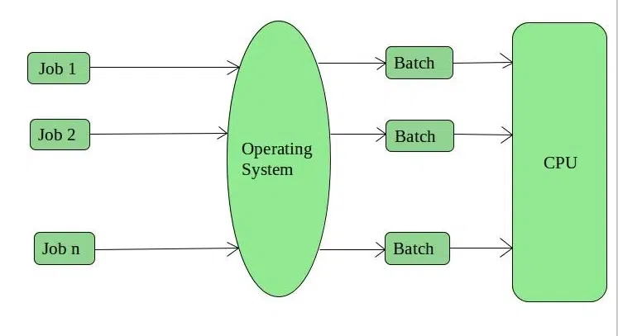
Different types of Operating Systems
Batch Operating System
To speed up processing, operators batched together jobs with
similar needs & run them through the computer as a group.
The limitations of a Batch System are as follows:-
User cannot interact with the computer when a job is executing.
In this execution, environment CPU is often idle.
The time gap between the job submission and completion of the job (turnround time) is quite maximum.

Slide 9
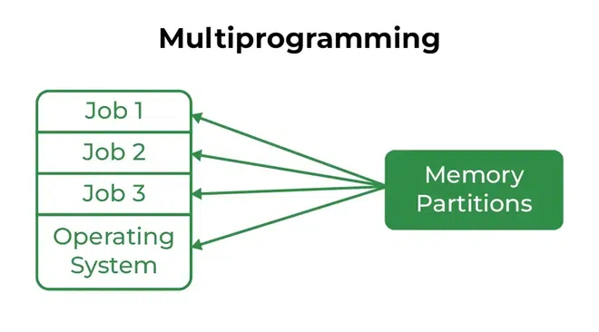
Multiprogramming System
Multiprogramming is needed for efficiency.
Single user cannot keep CPU and I/O devices busy at all times.
Multiprogramming organizes jobs (code and data) so, CPU always has one to execute.
A subset of total jobs in system is kept in memory.
One job selected and run via job scheduling.
When it has to wait (for I/O for example), OS switches to another job.

Slide 10
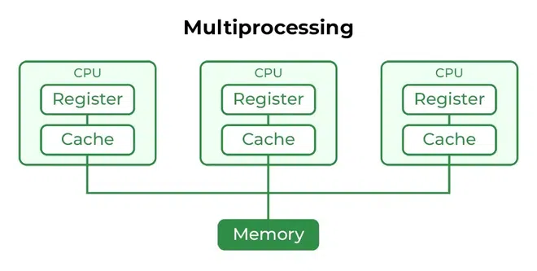
Multiprocessing System
Another computer system is the multiprocessor system having multiple processors sharing memory and peripheral devices.
Multiprocessor systems are classified into two as tightly-coupled and loosely-coupled (distributed).
In the tightly-coupled one, each processor is assigned a specific duty but processors work in close association, possibly sharing the same memory.
In the loosely coupled one, each processor has its own memory and copy of the OS.

Slide 11
Thank You!

